Slide 1

Agile
A view from the top
Colm O’hEocha – AgileInnovation Ltd

Slide 2
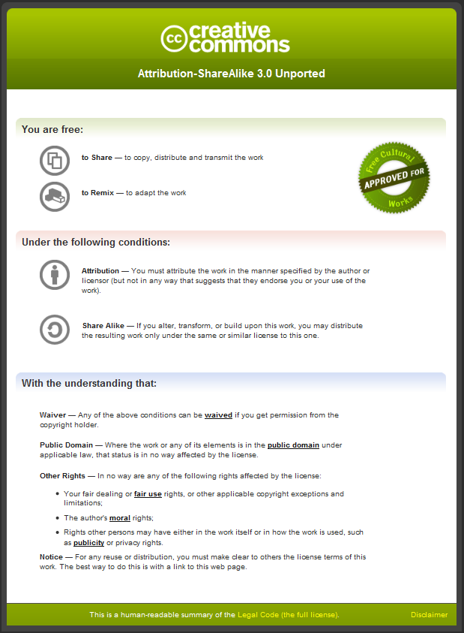
This material is Copyright Protected under the following Creative Commons License:
Attribution-ShareAlike 3.0
Please use this material freely and derive further work from it.
BUT, attribution must be given to the original author, and these same rights must govern all derived works.
Please use the following attribution:
“Colm O’hEocha, AgileInnovation Ltd. 2010: www.agileinnovation.eu”

Slide 3
Agile is Different
Agile – A View from the Top

Slide 4
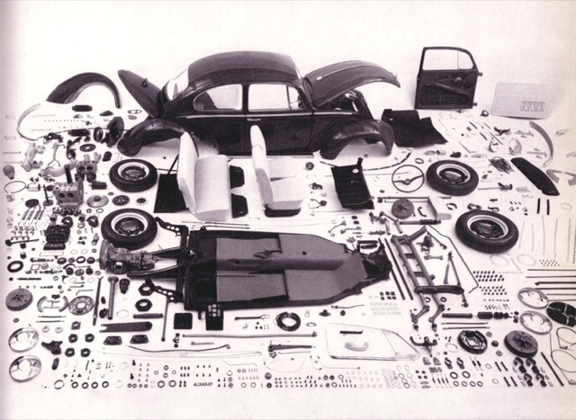
What is agile?

Slide 5
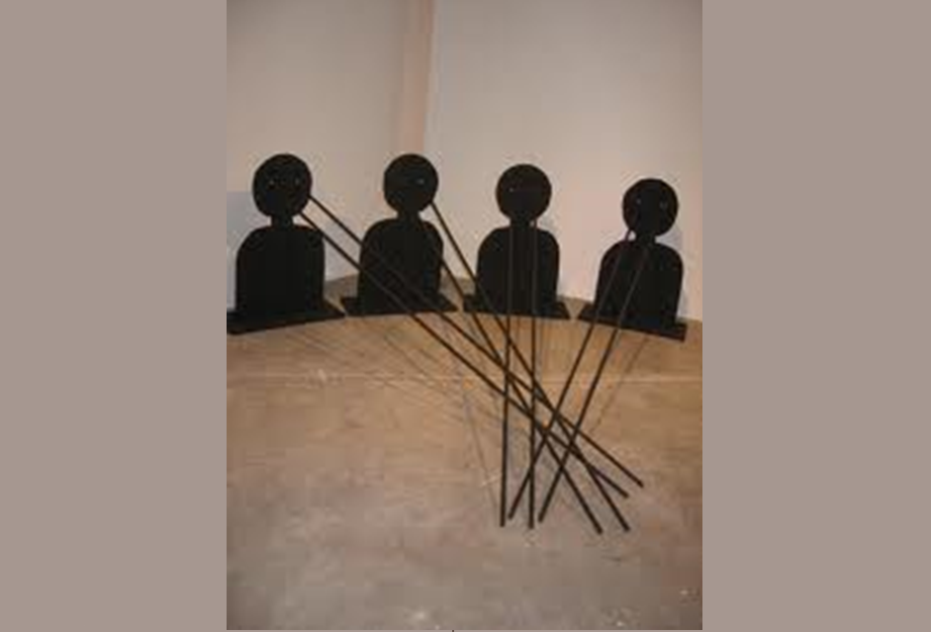
Perspectives
Different

Slide 6


Process Control Models
OPEN-LOOP
Analytical - Predictive
CLOSED-LOOP
Empirical - Adaptive
Controller
Controller
Set Target
Set Target
Inspect
“Reduce Change”
“Embrace Change”

Slide 7
The Parts and the Whole
Iteration Plan
Daily Stand-Up
Controller
Set Target
Adapt
Inspect
Clean Design & Code
User Stories - Late Elaboration
Shared Code Ownership
Test Driven Development…..
Pair Programming
Customer Reviews & Feedback
Retrospectives
AutoTest…..

Slide 8
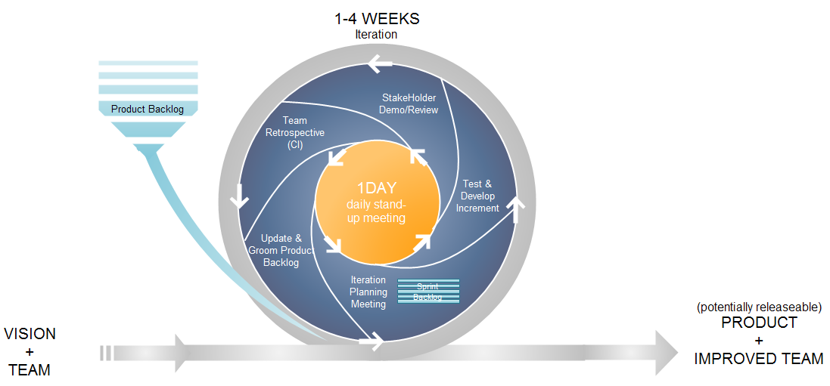
The Life of an Iteration

Slide 9
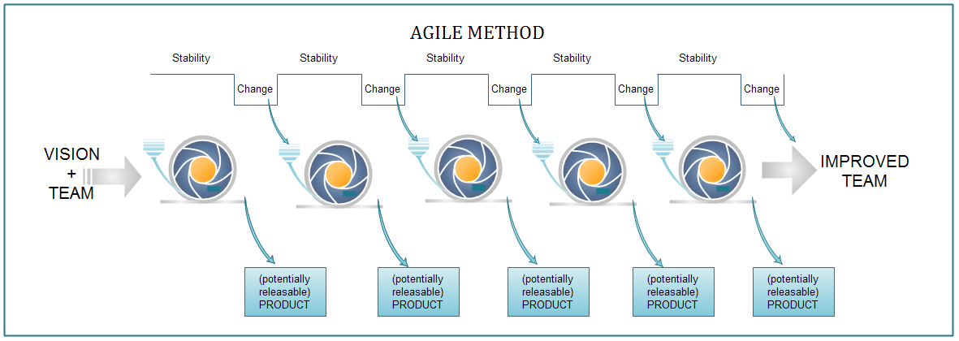
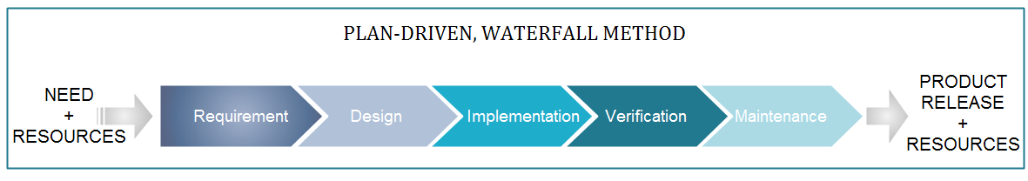

Slide 10
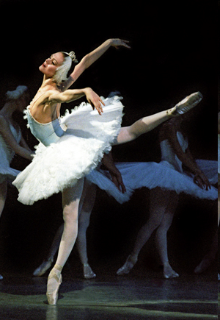
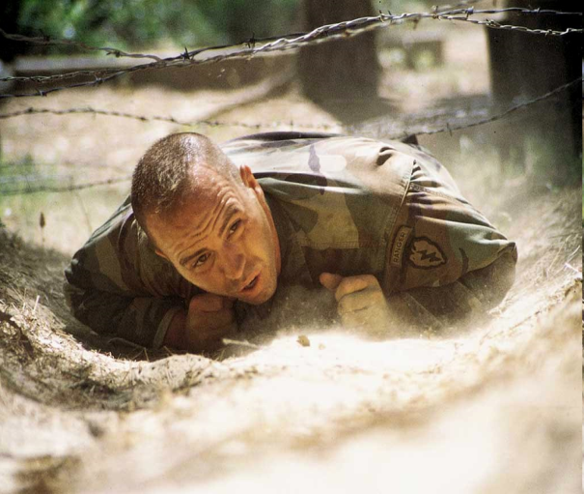
“Balancing Agility and Discipline”
Barry Boehm
Discipline
Agility

Slide 11
Agile is GOOD
Agile – A View from the Top

Slide 12
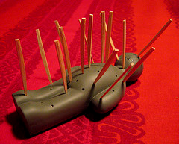
Painpoints
Your Favorite!
Responsiveness
Transparency
Complexity
Productivity
Long Cycle Times
Quality
Brittle Code
Ouch!

Slide 13
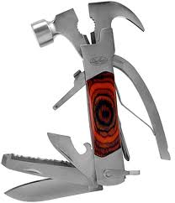
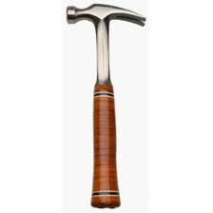
What we really needed was a good hammer…

Slide 14

Agile
Waterfall
Value Delivered
Resources
Time

Slide 15
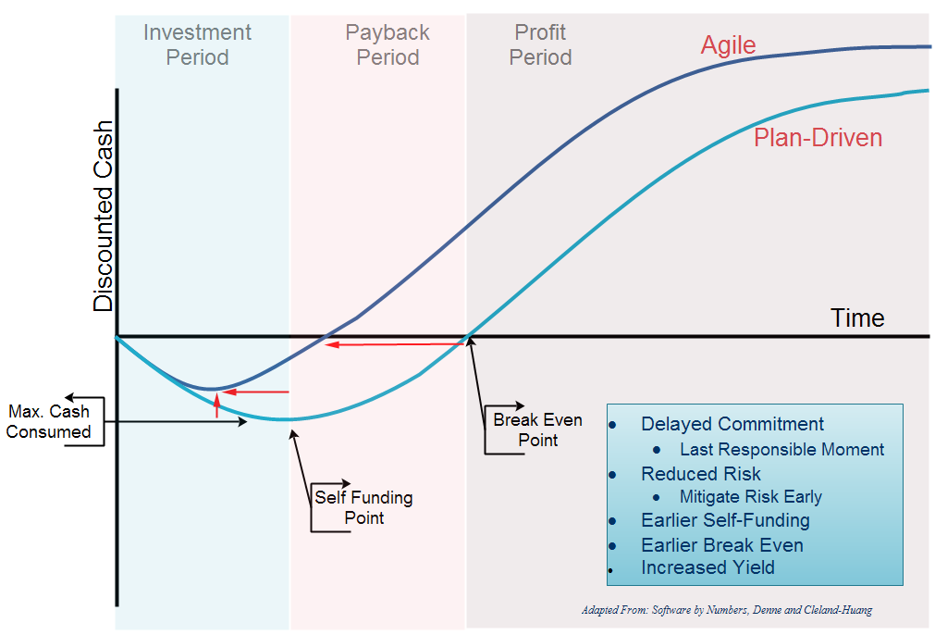

Slide 16
Quality
ERROR: No keyboard detected
Press any key to continue…
ERROR: No keyboard detected
Press any k
ey to con
tinue…^Z

Slide 17

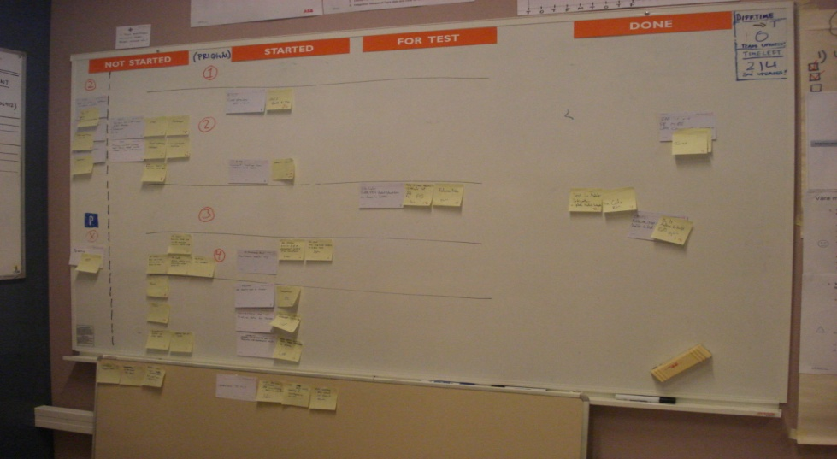
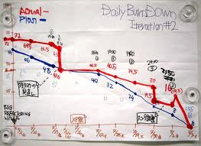
Transparency
“Tell me how you will measure me and I’ll tell you how I’ll behave”

Slide 18
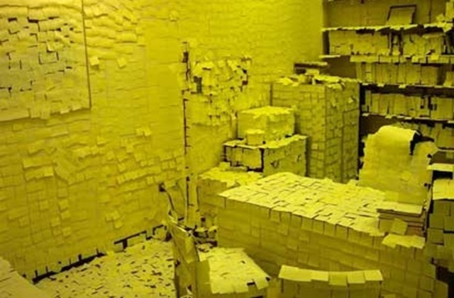

Slide 19
“Prediction is hard –
especially when its about the future”
Niels Bohr
13%
26%
33%
41%
48%
57%
68%
77%
83%
86%
91%
94%
97%
99%
8%
Cancel

Slide 20
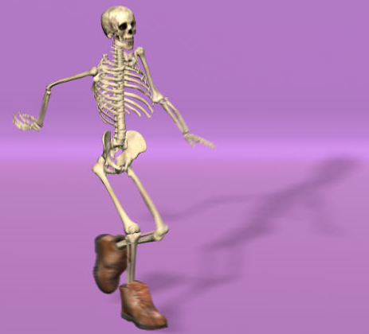

Slide 21
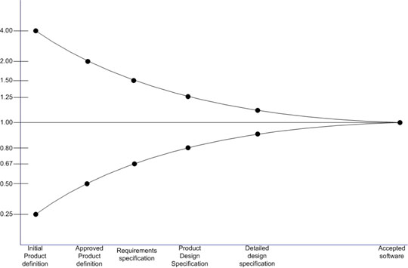







Cone of Uncertainty

Slide 22
Agile is MAINSTREAM
Agile – A View from the Top

Slide 23
Gaining Traction…
Gartner 2008: 15%-25% of Organisations have Implemented Agile
Capgemini 2009: Agile is no. 4 of the Top 5 IT Priorities for 2010
Gartner 2010: 80% of Software Development will use Agile by 2012
Data Source: Forrester/Dr. Dobbs Global Developer Technographics Survey Q3 2009

Slide 24
Hard Evidence…
QMSA 2009
37%
*4
16%

Slide 25
Where Next?
Agile – A View from the Top

Slide 26
The Agile Adoption Curve
The Agile Adoption Curve and ‘Chasms’
Awareness
Investigation
Consideration
Routinization
Pilot
Adoption
Adaptation
Acceptance
Infusion
“We’re different”
“Fail to Scale”
Initiation
Adoption
Assimilation

Slide 27
It depends…
Scientific Theory
Business Imperatives
Project, Team
and Organisational
Context
Agile Values & Principles
Your Method

Slide 28
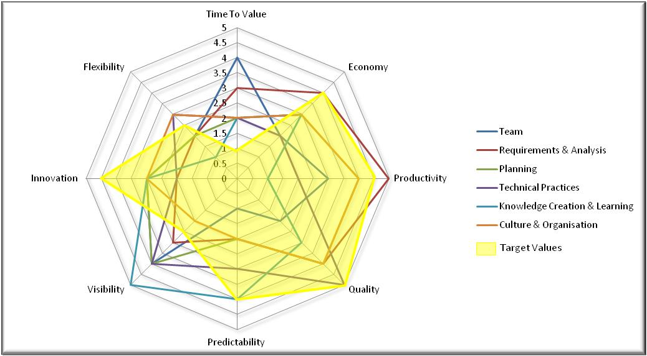
Where am I?
 | Team | Requirements & Analysis | Planning | Technical Practices | Knowledge Creation & Learning | Culture & Organisation
Time To Value | 4 | 3 | 2 | 2 | 2 | 2
Economy | 2 | 4 | 3 | 2 | 3 | 3
Productivity | 3 | 5 | 4 | 2 | 1 | 4
Quality | 2 | 4 | 4 | 5 | 3 | 4
Predictability | 1 | 2 | 2 | 3 | 4 | 2
Visibility | 4 | 3 | 4 | 4 | 5 | 2
Innovation | 3 | 2 | 3 | 2 | 3 | 3
Flexibility | 2 | 2 | 2 | 3 | 1 | 3
Assessment
Dimensions
Business
Drivers

Slide 29

Colm O’hEocha
AgileInnovation Limited
www.agileinnovation.eu
Colm@agileinnovation.eu

Slide 30
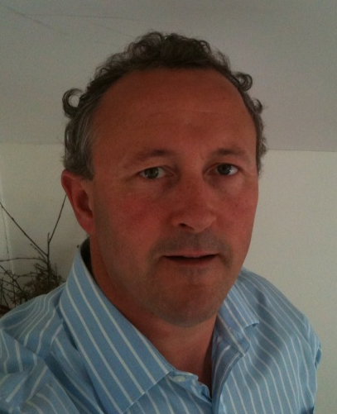
About the Presenter
Colm O’hEocha,
AgileInnovation Ltd.
Colm@agileinnovation.eu
Colm is an IT industry veteran, with over 20 years design and development experience. His interest in Lean Thinking began when automating Just-In-Time production lines in the 1980s. Implementing early agile software methods in 2001, Colm has extensive hands-on experiences across teams, organisations and technologies. In varied roles of developer, architect and Director of R&D, he has seen Lean and Agile from a variety of perspectives. More recently Colm has partnered with LERO, the Irish software engineering research institute, investigating how agile and lean methods influence innovation in software development.
AgileInnovation offers agile advisory and coaching services. Pre and post adoption assessments, coaching services to help teams get the most from agile, developing a agile business case, and targeted workshops on specific agile practices.

Slide 31
This material is Copyright Protected under the following Creative Commons License:
Attribution-ShareAlike 3.0
Please use this material freely and derive further work from it.
BUT, attribution must be given to the original author, and these same rights must govern all derived works.
Please use the following attribution:
“Colm O’hEocha, AgileInnovation Ltd. 2010: www.agileinnovation.eu”

